Slide 1
STLs I

Slide 2
Agenda
Vector
Queue
Stack
Deque

Slide 3
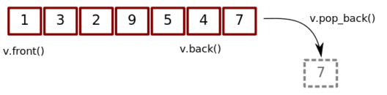
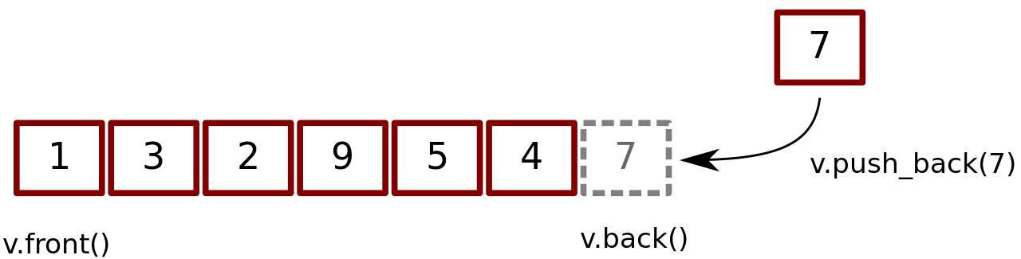
Vector
Vectors are resizable dynamic arrays
They can change their size automatically while adding or removing elements during runtime
They provide more flexibility than the normal static arrays

Slide 4
Vector
Declare a vector:
vector <int> myVector ;
Declare with a specific size:
vector <int> myVector(7) ;
Declare with initial values:
vector <int> myVector={5,2,8,1} ;

Slide 5
Vector
Append (add to the end):
myVector.push_back(10) ;
Remove from the end:
myVector.pop_back() ;
The size of a vector:
myVector.size() ;

Slide 6
Vector
Access the third element (index 2):
myVector[2] ;
Change the value of the second element to 6:
myVector[1]=6 ;
Check if it’s empty():
myVector.empty();

Slide 7
Vector
Access the first element:
myVector.front() ;
Access the last element:
myVector.back() ;
Clear a vector:
myVector.clear() ;

Slide 8
Vector
Iterator for the first element:
myVector.begin() ;
Iterator for the after last element:
myVector.end() ;
Those Iterators are mainly for manipulating with functions:
sort(myVector.begin(), myVector.end());

Slide 9
Vector
Iterating over all elements (normal for loop with index):
for(int i=0; i<myVector.size(); i++){}
Iterating over all elements (for each with value):
for(int val : myVector){}
For more about vectors, check this: vector - C++ Ref

Slide 10
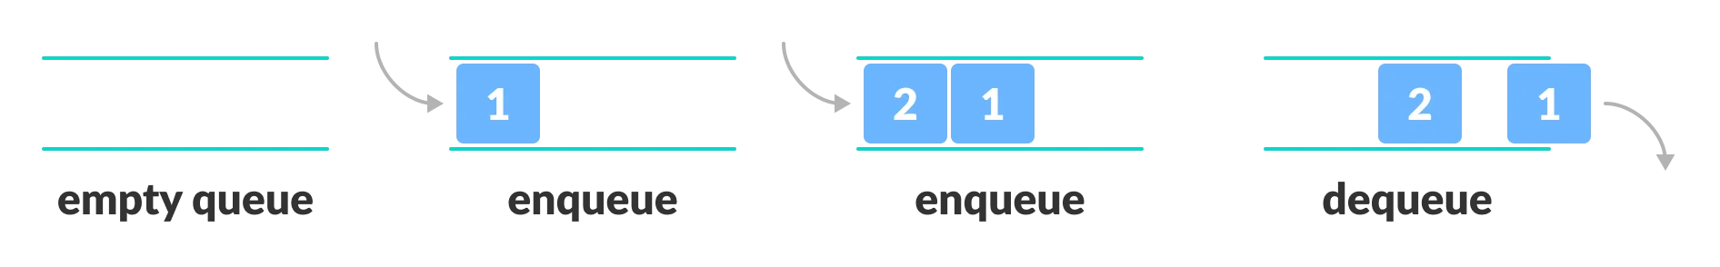
Queue
It’s a linear data structure that is designed to work as FIFO (First In First Out)

Slide 11
Queue
Declare a queue:
queue <int> myQueue ;
Enqueue (add to the queue):
myQueue.push(5);
Dequeue (remove from the queue):
myQueue.pop();

Slide 12
Queue
Access the first element (the next to be popped):
myQueue.front() ;
Access the last element (the last pushed element):
myQueue.back();
The size of a queue:
myQueue.size();

Slide 13
Queue
Check if it’s empty():
myQueue.empty() ;
For more about vectors, check this: queue - C++ Ref

Slide 14
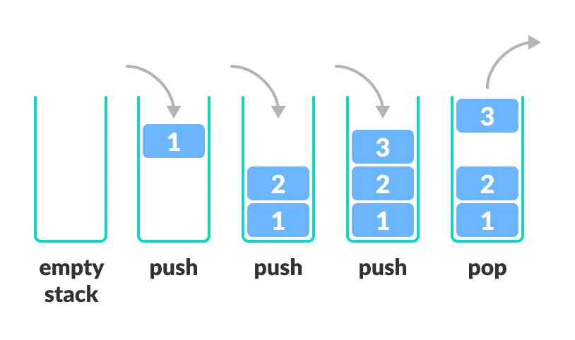
Stack
It’s a linear data structure that is designed to work as LIFO (Last In First Out)

Slide 15
Stack
Declare a stack:
Stack <int> myStack;
Push to the stack:
myStack.push(6);
Pop from the stack:
myStack.pop();

Slide 16
Stack
Access the top of a stack:
myStack.top() ;
The size of a stack: myStack.size();
Check if it’s empty myStack.empty();
For more about stacks, check this: stack - C++ Ref

Slide 17
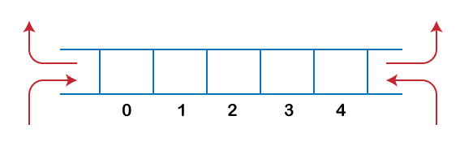
Deque
It’s a Double-Ended Queue that provide the same functionality as vectors in addition to insertion and deletion from the beginning

Slide 18
Deque
It provides the same previously mentioned vector’s functionality
Add an element to the beginning:
myDeque.push_front(4);
Remove an element from the beginning:
myDeque.pop_front();
For more about Deques, check this: deque - C++ Ref

Slide 19
To Solve
Valid Parentheses
Time Needed to Buy Tickets
Implement Queue using Stacks
Ada and Queue

